Slide 1
Faculty Senate Meeting
24 April 2025

Slide 2
Meeting procedure
Only Senators may debate motions
Only Senators can vote
If you are not a Senator, or a proxy, you cannot vote or debate
Do not speak over someone, or out of order
  Raise your hand (For those online please use “Raise Hand” on the Zoom app)
  The President will call on you and then you will have the floor
  Please wait for the microphone
Unless you have been recognized (told you have the floor), you may not speak

Slide 3
I. Call to order
D. Westenberg, President

Slide 4
II. Roll Call
J. Schlegel, Secretary

Slide 5
III. Consent Agenda
D. Westenberg

Slide 6
Consent Agenda
Approval of the 20 March 2025 Minutes
Campus Curriculum Committee moves to approve CC and DC forms from their last meeting

Slide 7
IV. President’s Report
D. Westenberg

Slide 8
IFC – 4/7/2025, Virtual
Topics discussed
Impact of federal actions on research funding, student enrollment, retirement benefits
Update on immigration policies and students having visas revoked – university cannot provide any guidance or resources for impacted students – MU International Student and Scholar Services has shared guidance documents with each campus
Update on DOE Dear Colleague Letter and academic freedom
Next meeting, May 5, In person

Slide 9
Campus Matters
Leadership Meetings
See Miner Momentum for topics discussed
Updates on enrollment – still positive
Library overview
Campus master plan update for residential life
Advising structure updates

Slide 10

Campus Matters
Other topics
Faculty/Staff Climate survey is open
  Encourage colleagues to complete
Provost search
  Campus visits coming soon
General Faculty Meeting – May 6
StuCo Joint Resolution

Slide 11
2425JR1: Joint Resolution in Support of Class Alternatives on Inclement Weather Days
WHEREAS, there has been a recent increase in scrutiny upon the policies for closure and remote operations of the campus; and
WHEREAS, there are concerns among members of the Faculty on the additional workload and logistics associated with a sudden change to remote learning; and
WHEREAS, a significant portion of lectures and labs do not lend themselves well to being taught in an online format; and
WHEREAS, some members of the Student Body and Faculty may not have the equipment or facilities necessary to fully participate in remote learning; and
WHEREAS, rates of absence, loss of focus, and non-participation in synchronous activities on inclement winter weather days are significantly above that of normal days; and
WHEREAS, the preceding three factors can contribute to poorer student performance; and
WHEREAS, decisions on class format changes, cancellations, and rescheduling are best made on an individual basis depending on the unique circumstances of each class,

Slide 12
2425JR1: Joint Resolution in Support of Class Alternatives on Inclement Weather Days
THEREFORE, BE IT RESOLVED that decisions of class format on inclement weather days ought to be made by the Faculty or Course Coordinators; and
BE IT FURTHER RESOLVED that Faculty are requested to provide leniency on attendance, assignments, and other academic requirements that are impacted by a closure of campus or inclement weather; and
BE IT FURTHER RESOLVED that the Student Council and Faculty Senate jointly petition the Administration of the Missouri University of Science and Technology to adopt policies and Faculty expectations supporting the same.
Notes:
Notes:
Must be independently approved by Faculty Senate and Student Council
With no revisions between the two
Please submit all suggested revisions before the final Student Council Meeting on April 29th
Before Noon that day would be ideal

Slide 13
Campus Matters
Talk of the Town Follow - up
Thank you to everyone who attended
Next steps?

Slide 14
Campus Matters
Good News
Woman of the Year – Jessica Cundiff
Women's Advocate – Jessica Gargus
Bioplex groundbreaking
Bring your child to work day – big success
Men’s Golf – Conference Champions

Slide 15
Be Involved
Be Engaged
Do Something

Slide 16
V. Campus Reports
A. Staff Council
K. Walkup

Slide 17
Giving Days
Huge success, THANK YOU to all that donated!
Over $3k donated to Staff Council alone!
Total of 555 donors raising $175k across campus!

Slide 18
Spring 2025 Staff Appreciation Day WEEK!!
Not finalized, but get excited!
Date: May 19-22, 2025 - “Spirit Week”
19 - TBD
20 - TBD
21 - 8a Staff Day Opening Ceremony
22 - Mammogram Truck
Daily - Makers Studio Lab (make.mst.edu)
Location: Innovation Lab
Theme: Game Show

Slide 19
V. Campus Reports
B. Student Council
M. De La Hunt

Slide 20
Final Update on Projects
Final Rush of Action from STUCO!
Resolutions:
  On welcome center artwork
  Construction transparency and sustainability
  Requesting no assignments be due during university assigned holidays
  Requesting no back-to-back exam weeks during pre-finals and finals weeks
  Two more resolutions to be considered Apr. 29
  Joint Resolution with Faculty Senate
Bills:
  Created Alumni Group for advising STUCO Executives
  Various internal changes
  In-Progress Addition of a Lifetime Achievement Award

Slide 21
Final Update on Projects
Student Interest Survey
  April 22 – April 29
  Encourage your students to respond!
Executive Applications
  https://stuco.mst.edu/join#exec
Academic Resources Investigation
  Will be discussed in a few moments
Wrapping up my term
  Holding transition meetings with what feels like half of campus
  April 29th – Final STUCO Meeting
Preparing Student Leader Awards Banquet
  Reach out if you would like information on awards and how to nominate a student

Slide 22
Aiden Pickett
Student Body President elect
Term Begins April 29th

Slide 23
Academic Resources Investigation
Delaney Pipkin
Vice President of Academic Affairs
Lillie Zimmermann
Academic Resources Lead

Slide 24
Students Voice on Academic Resources
Presented by Student Council
April 2025

Slide 25
Agenda
  Overview
  Part 1: S&T Courses' Resources
    Best Practices and Examples
  Part 2: Information Before Course Start Date
    Student Polling
    Competitor Schools Resources
  Next Steps: Recommendations for Improvement
    Reconfiguring Existing Information
    Partnering with Faculty and Administration
    Potential New Additions

Slide 26
Part 1: Course Information Availability
At Missouri S&T

Slide 27
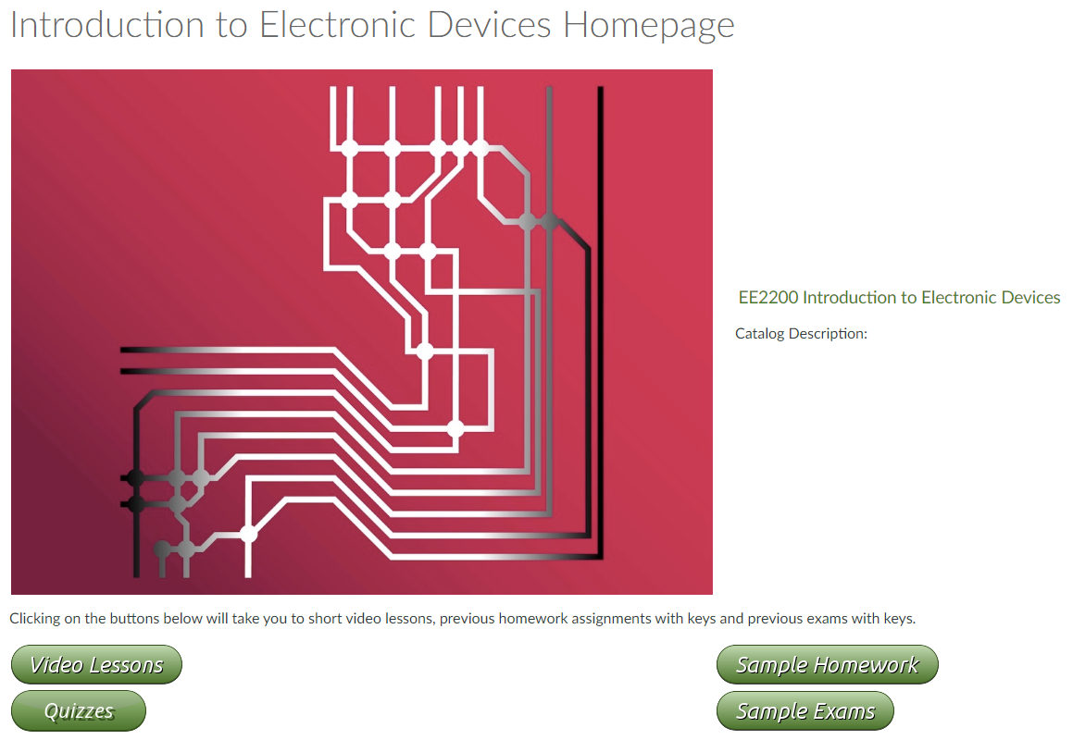
Dr. Swift's (EE) Public Canvas Course
  Combines courses in one location
  Lecture videos for reference
  Old problems for concept application and additional practice
    Broken down by topic

Slide 28
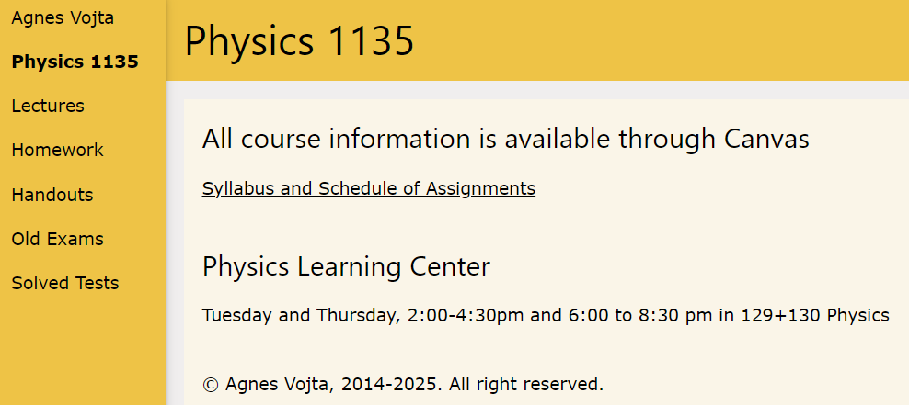
Dr. Voita's Physics 1 Course
    Additional videos for examples
    Old exams for practice
      Understanding of questions' structure
    Grade known
    Learning Resources Listed

Slide 29
Dr. Libre's Mechanics Of Materials
    Additional videos for examples
    Practice Exams
    Formula sheet

Slide 30
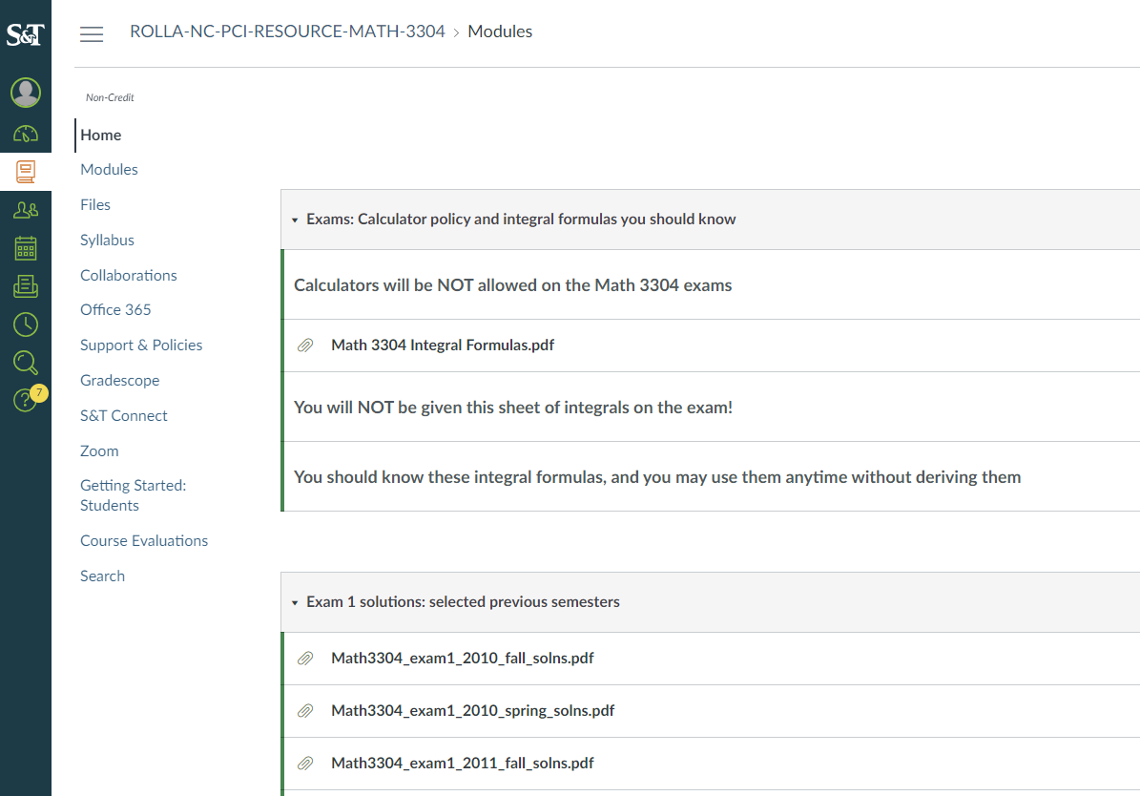
Differential Equations Public Course
    Detailed formula sheet available before exam for review
    Old exams and answer keys
    Difficult to find

Slide 31
Bad Course Formatting Experiences
    Behind expected course pacing
    Not opening Canvas course until over a week after school has begun
      With no communication from professor

Slide 32
Conclusion
Favorite Features
  Old exams
  Detailed syllabi with definite grade breakdown
  Past lecture videos and notes as a reference
  Combining professors' resources for mutual topics
Minimum Improvements
  Work not graded for long periods of time
  Lack of communication from professors
  Auto-access link consistency
  Lack of information before class begins

Slide 33
Part 2: Pre-Course Information
At Missouri S&T

Slide 34
Student Poll
Resources Ranked by Students:
Access to Old Tests for preparation.
Access to course lecture videos and PowerPoint notes
Additional Practice Problems and Examples
An up-to-date course catalog description
Information on course expected workload
Average course GPA per semester
Information on resources offered for the course (LEAD, tutoring, PLC, etc.) in advance
Access to which semester a course is offered and by which professor
Access to historical syllabi
Easier Access to SET Results
Created based on student interest and suggestions.
Presented during the Student Council Meeting and shared with RSOs.
162 Responses.

Slide 35
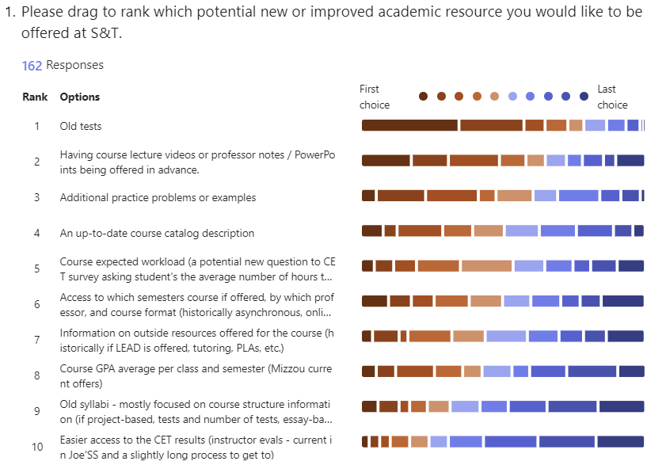
Results Visual Breakdown
Students are first focused on resources during the course, but also before a course begins
Notes:
Currently in the works for some, but please continue to collaborate with studetns to we can ensure it is benefital information. Course catalogs in the works, pushing syllabi on simple syllabus, course offerings pushed by advisors, etc.

Slide 36
Other Campus Offerings
Competitors Analyzed: Mizzou, Purdue, Georgia Tech, UVA

Slide 37
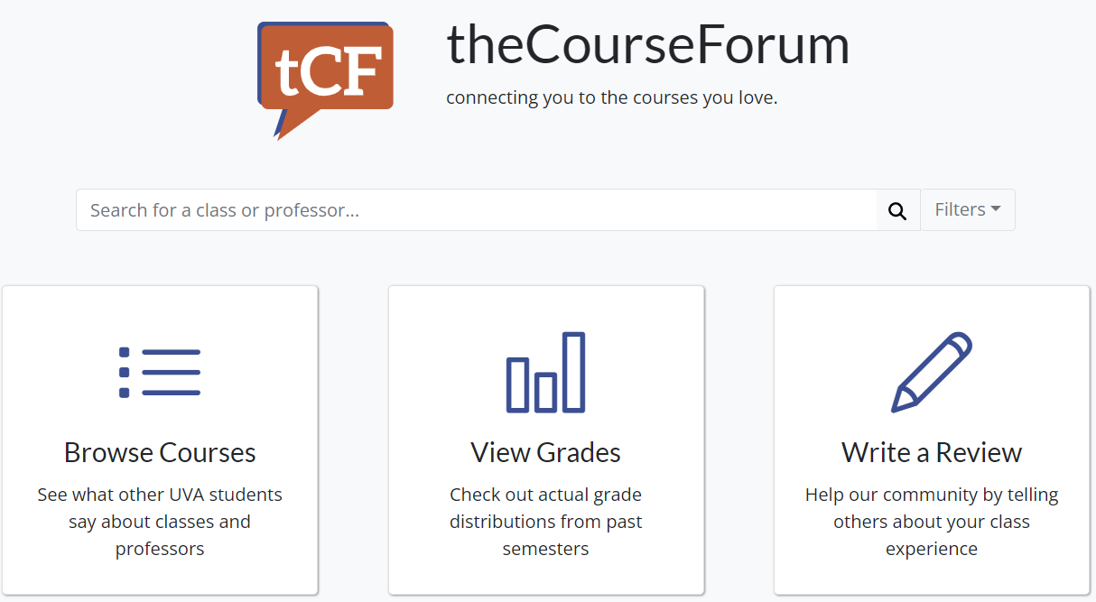
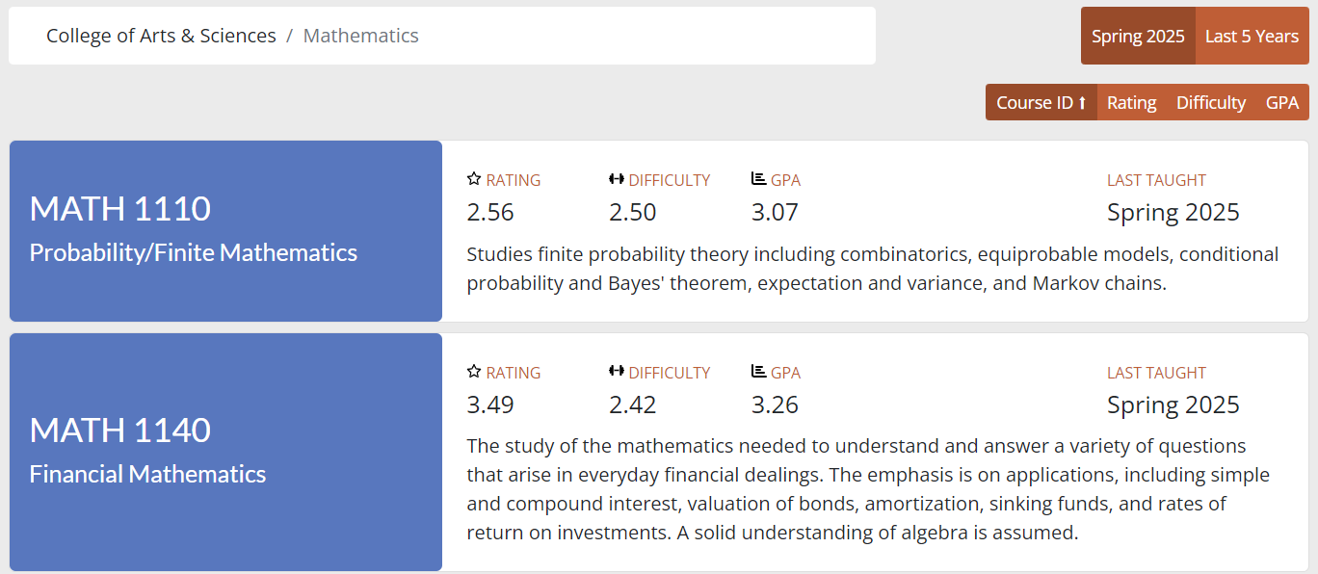
University of Virginia
Internal review of classes
  Workload distribution
Difficulty ratings and GPA by semester

Slide 38
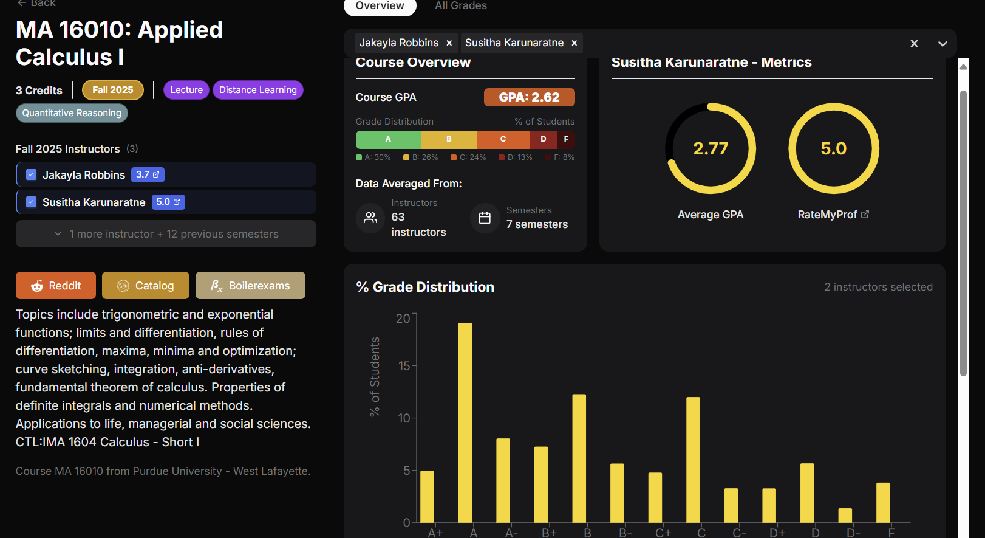
Purdue: Boiler Classes
Grade Distributions
Class Offered Format and Structure
Class Offerings
Instructors

Slide 39
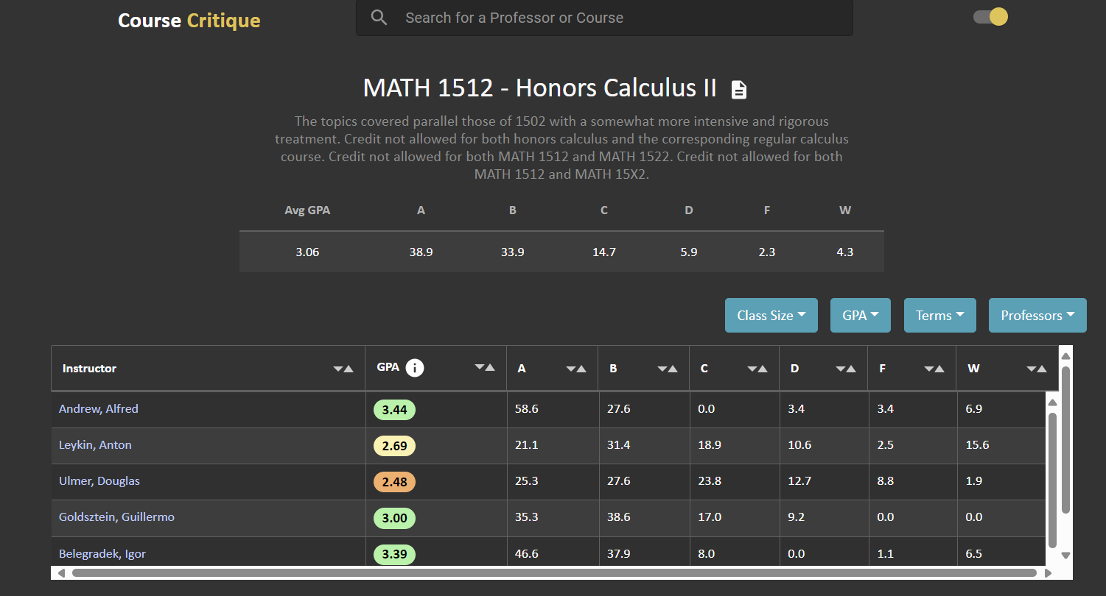
Georgia Tech: Course Critique
Grade distributions with professor, class size, and term breakdown
Course Description
Internal Website

Slide 40
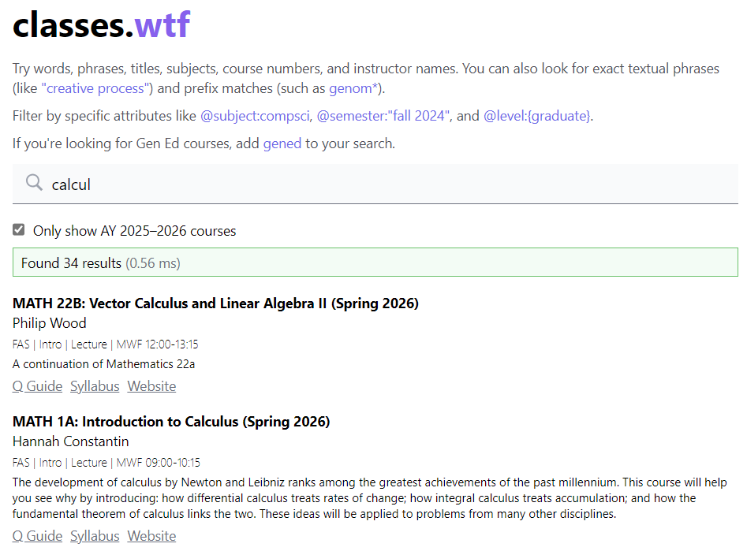
Harvard
Can look at syllabi behind SSO login
Guide to the course
If there is an associated website

Slide 41
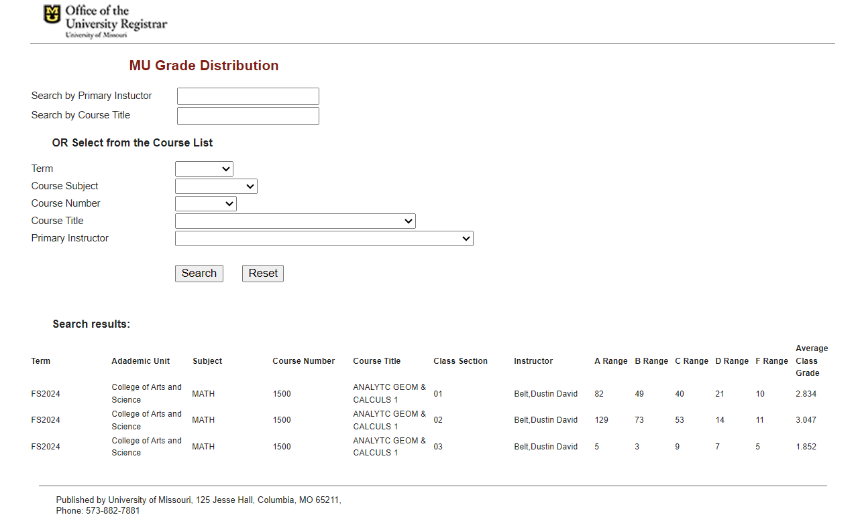
Mizzou: Grade Distributions
Search by:
  Term
  Professor
  Subject
  Class

Slide 42
Conclusion
Favorite Features
    Difficulty rating of course
      Potentially similar to an expected workload question
    GPA distribution
    Instructor information
    This information will help prepare students for the semester, easing anxiety, and assisting with retention

Slide 43
Potential Solutions
Faculty Collaboration, Stellic, MyS&T

Slide 44
List of Recommendations
Provide standardized training for Canvas so all professors provide basic information in a standardized way (grading, textbook access, syllabi, Student Success Center information)
Expected workload or challenge rating for courses on the SET
Provide old assignments or exams as practice
Create a central location for course information with information on format, GPA, instructors, semesters offered, etc.

Slide 45
Questions?

Slide 46
Key Priorities (From Sep. 19)
Renegotiation of Student Activity Fee and other funding on campus with administration
Better inform students during advising and registration process
  In Progress: Course Information System, Advising Overhaul
Work with CET Committee to increase student response rate
  In Progress: CET Info Availability, Increased Benefit to Students
More engagement from Student Council members
Increase communication with administrators and faculty

Slide 47
To Conclude
Thank you!
Incoming Officers
Successful Year for STUCO
  Lots of major actions taken
  “Make the voice of the students a force to be reckoned with”
  Hoping to keep momentum next year
From Me:
  It has been an honor to work with you all
  Best of luck next year!
Aiden Pickett
Student Body President
Lillie Zimmermann
Vice President, Engagement and Outreach
Neil Maxwell
Vice President, Operations
Audrey Tang
Vice President, Student Services
Shawn Rottinghaus
Vice President, Academic Affairs

Slide 48
Questions?
Contact Information
stuco@mst.edu
(573) 341-4280
Room 232, Havener Center
https://stuco.mst.edu
Office Hours available on our website
Martin De La Hunt
martin.delahunt@mst.edu

Slide 49
V. Campus Reports
C. Council of Graduate
Students

Slide 50
Council of Graduate Students
No report

Slide 51
VI. Special Topics
A. Missouri S&T
Financial Outlook
A. O’Neil

Slide 52
Agenda
Risk Factors
Strategy
FY26 Outlook
Capital project funding sources

Slide 53
Risk factors – Federal level
Changes to Indirect Cost Recovery rates (NIH, DOE)
Rescission of awarded grants/Fewer future grant opportunities generally
  However - S&T is a national leader in many areas with strong bipartisan support
Impact of policy change on financial markets & risk of recession
Changes to student assistance programs
  Student Loans, Pell grants, etc

Slide 54
Risk factors – State level
  Medicaid reform
  State tax collections are down year over year in 2025
  State’s fund balance remains high providing the state with a runway to adapt to falling revenues; however, resources are committed to capital.
  The past four appropriation reductions have ranged from 9-12%
    2001 Recession: 12%
    2007-2009 “Great Recession”: 12%
    2016-2017 Austerity: 9%
    2020 COVID Recession: 11%

Slide 55
Medicaid continues to crowd out other spending

Slide 56
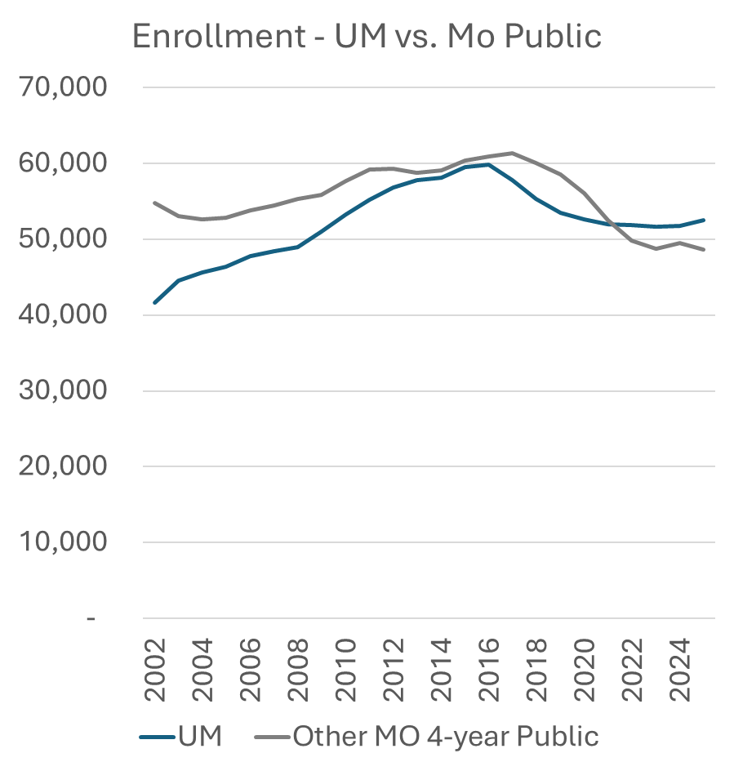
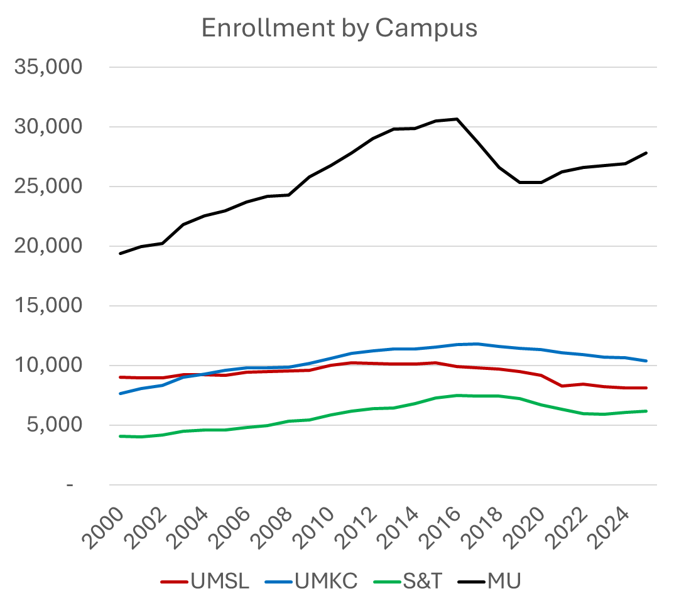
Risk Factors: Enrollment
…Intense competition for students

Slide 57
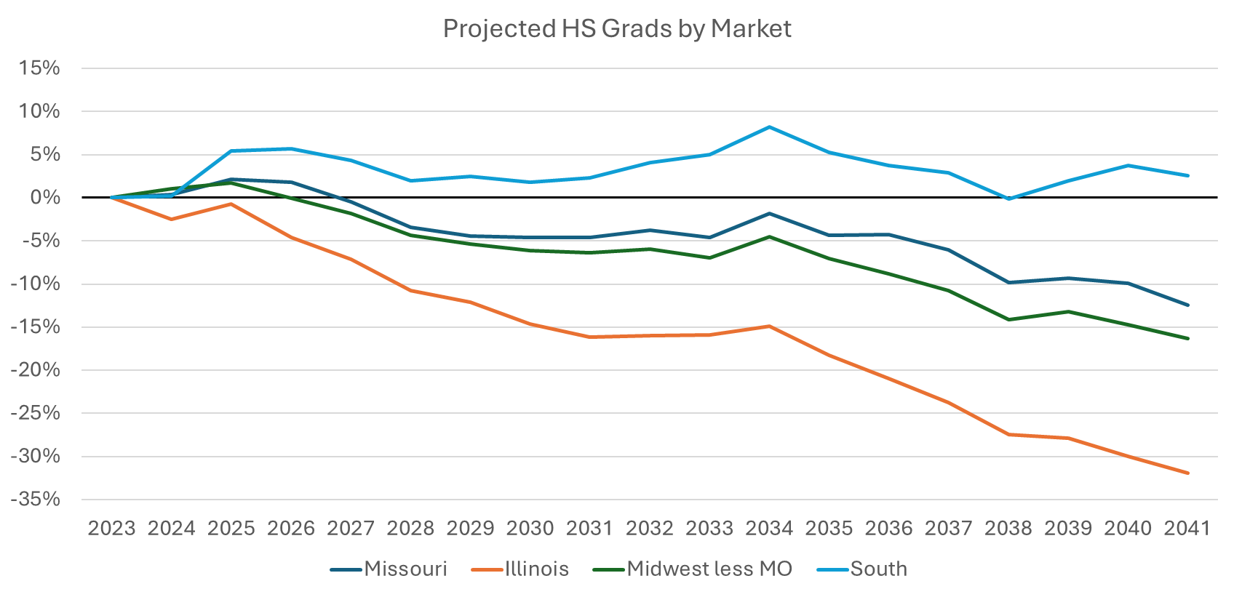
Risk Factors: Enrollment
…and competition will only increase

Slide 58
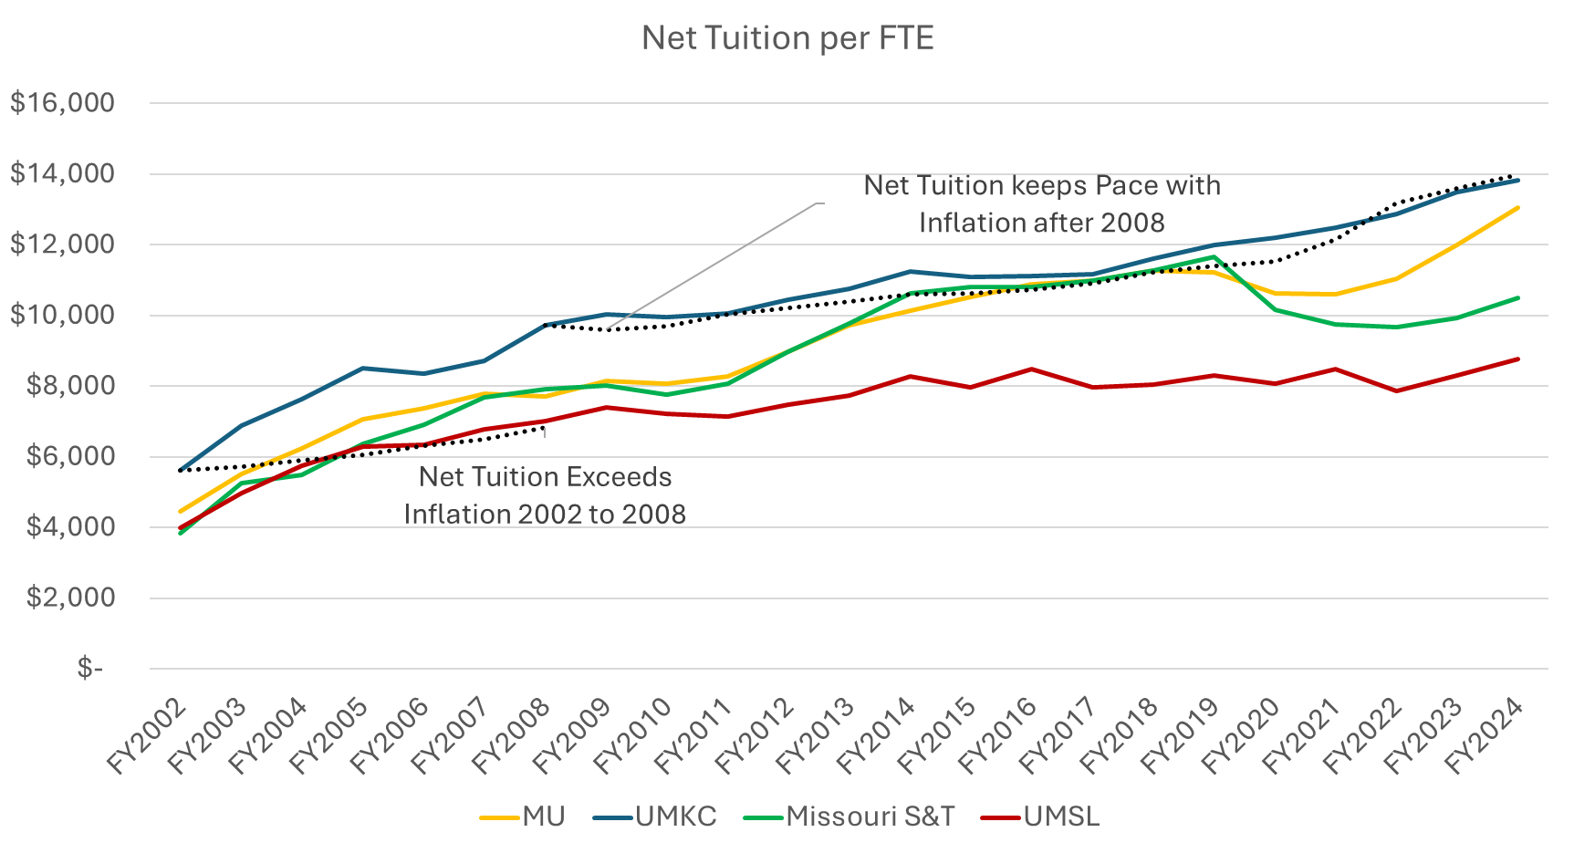
Risk factors: Enrollment
…focus on net tuition is critical

Slide 59
Proactive response to potential risks
…with a focus on mission and strategy
Immediate strategies
Budget reduction scenarios submitted by division leaders April 7
$2.9M (2.5%) reallocation communicated to division leaders
Evaluation criteria:
Impact to mission, people and ability to generate revenue
Hiring restrictions
Long-term strategies
Benchmarking administrative cost to peers
Review of key revenue sharing policies
Focus on net tuition and enrollment growth
Continuous Improvement
Academic excellence
Administrative efficiency
Revenue enhancement
Resource utilization

Slide 60
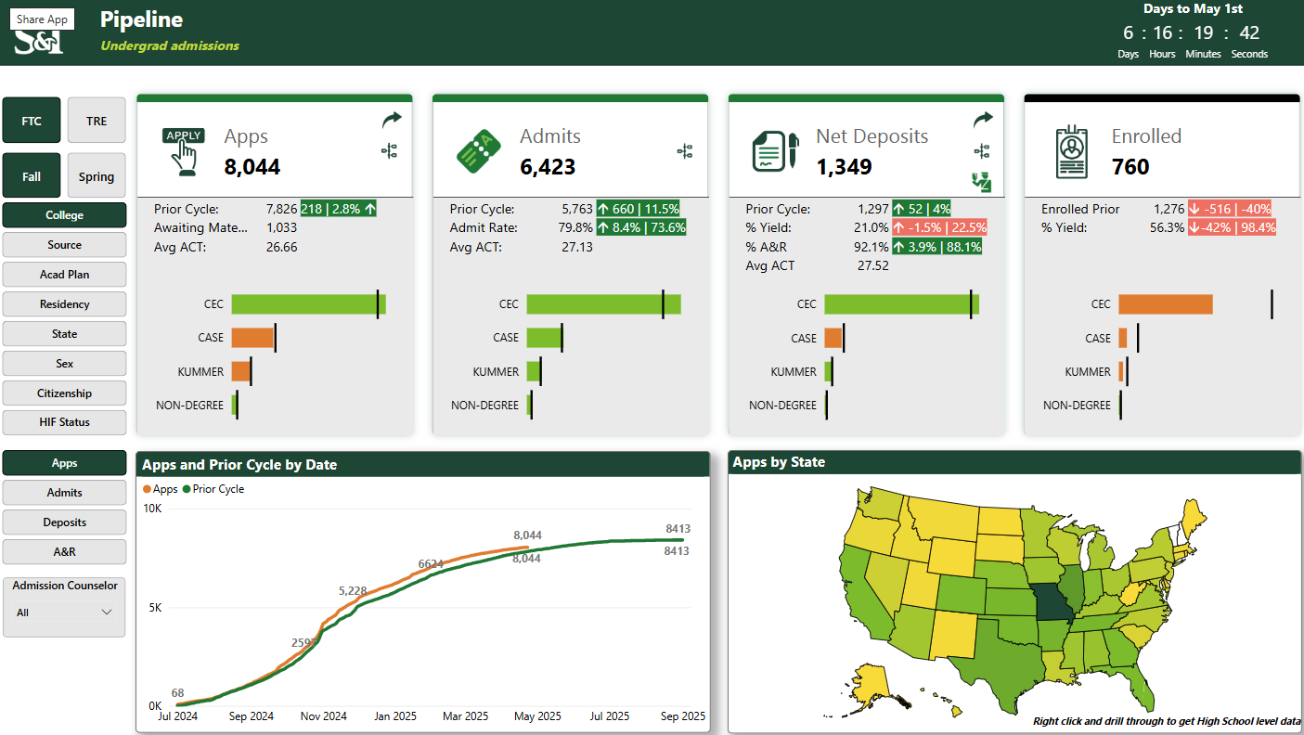
Enrollment Dashboard
As of 04/23/2025

Slide 61
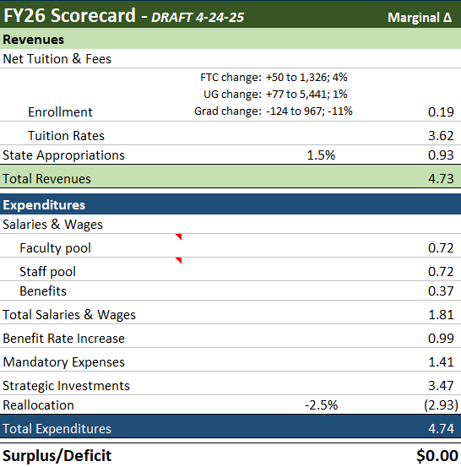
Current scenario:
…as of 4-24-25
First-time College: 4% increase
New International Grad: 20% decrease
Tuition increase: 3-5%
State: 1.5% increase
$1.81M set aside for merit program
$2.93M reallocation

Slide 62
Strategic Investments
…ranging from $25k to $500k+
Strategic Investments (recurring)
Desktop Enhancement
Research Support in Colleges - Yr 3 of 3
Promotion & Tenure
Post Tenure Awards
Admissions E&E
Enrollment Strategist (1FTE)
Market/Equity adjustment
Athletics shortfall
Supplemental Core Instruction
Faculty lines
National Visibility/Program specific marketing
AMCL (Core Facility) annual operating cost
Library Acquisitions
IT Personnel

Slide 63
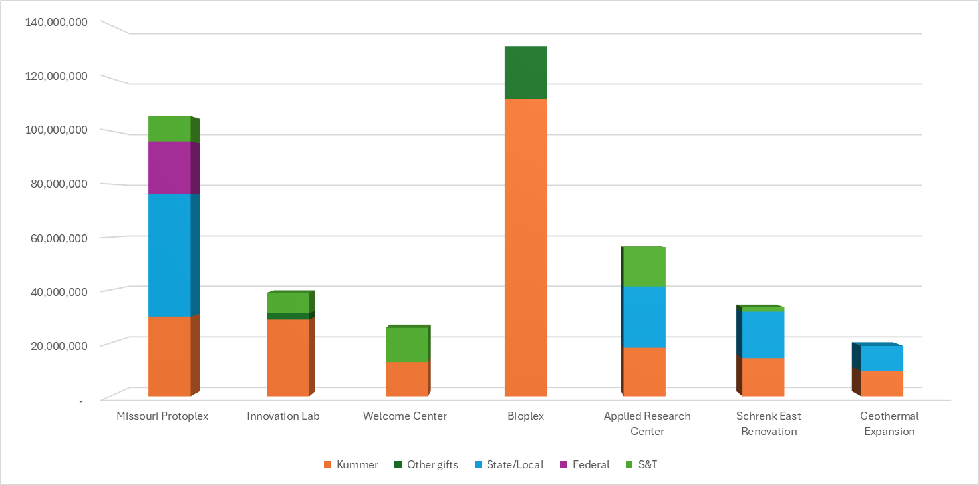
Capital Project Funding Sources

Slide 64
VII. Committee Reports
A. Budgetary Affairs
B. Lea

Slide 65
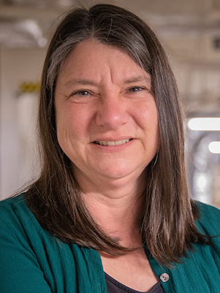
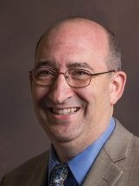
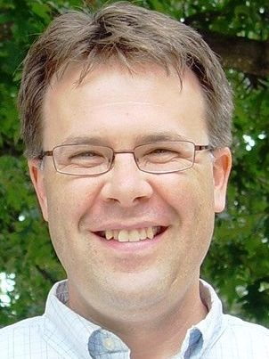
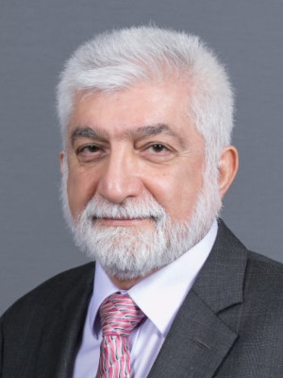
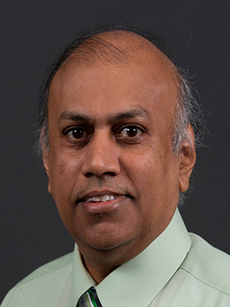
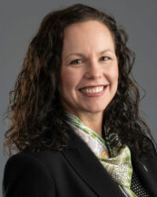
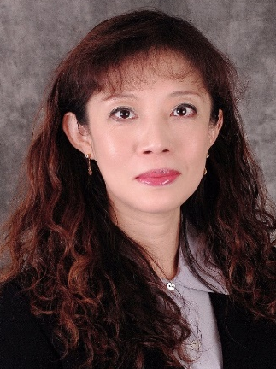
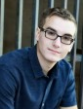
Budgetary Affairs Committee (BAC)
04-24-2025 Report
Special Topics
  Feedback to VCFO
Emerging Issues & Referrals
  Positions & Salary: Executives, Faculty, and Staff -2
  BAC ongoing plans
Financial Position
  Per VCFO Special Topics
Dr. Melanie Mormile mmormile@mst.edu
CASE
Dr. David Bayless dbayless@mst.edu
CEC
Dr. Kelly Homan khoman@mst.edu
CEC
Dr. Ali Hurson hurson@mst.edu
CEC
Dr. Jag Sarangapani sarangap@mst.edu
CEC
CFO Alysha O'Neil alysha.oneil@mst.edu
Finance & Operations
Dr. Bih-Ru Lea (Chair) leabi@mst.edu
Kummer College
Mr. Logan Garton wgcf2@mst.edu
Student Council, Civil Eng

Slide 66
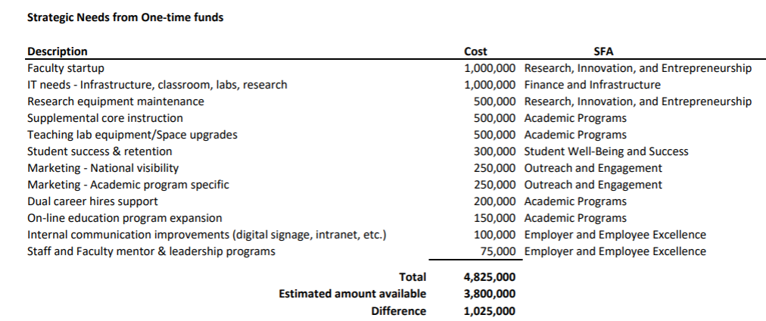
FY 26 Strategic Needs Proposal
Refer to the VCFO Special Topic Report
Strategic needs from reallocation 2026.pdf

Slide 67
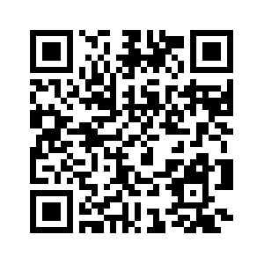
Provide Feedback
https://tinyurl.com/SandTBudget

Slide 68
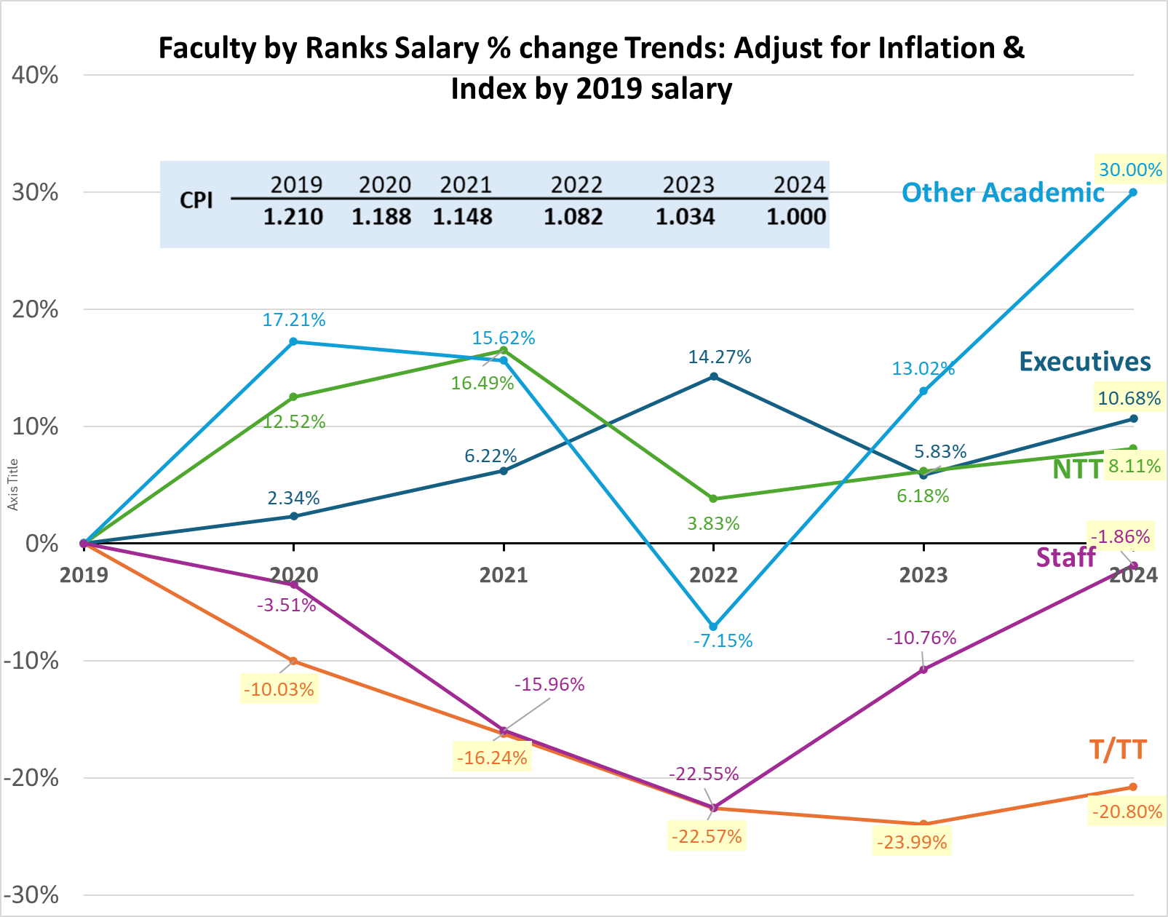
Other Academic primarily includes full-time post doc fellows, visiting scholars/profs, and Librarians.

Slide 69
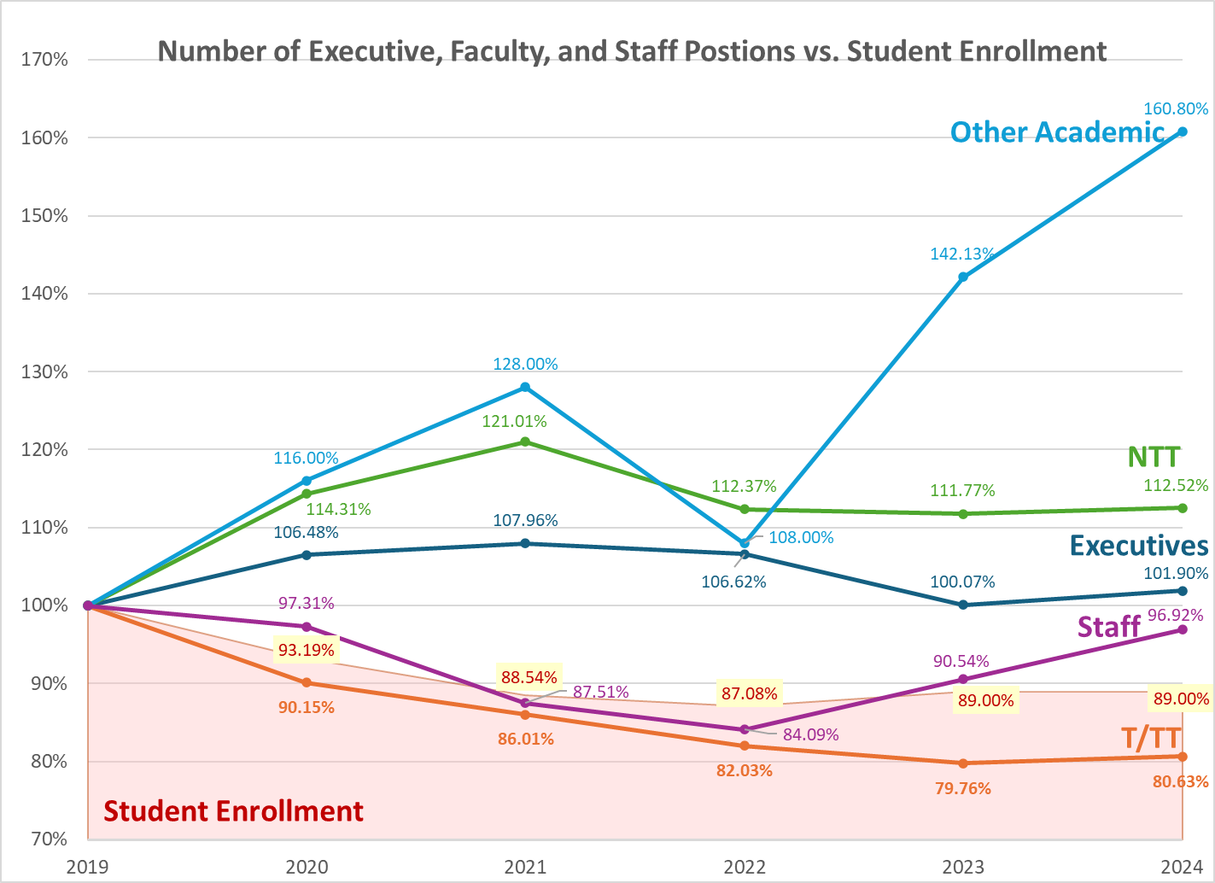
Overall Observation:
Enrollment is at 89% of the 2019 level
Total salary investment and number of positions in T/TT at 79.2% and 80.63%, respectively, of the 2019 level.

Slide 70
Public R1/2, 5-20K
Border States (9 Universities)
Comparison Data Reports
Data Source: Integrated Postsecondary Education Data System (IPEDS)
https://nces.ed.gov/ipeds/datacenter/institutionlist.aspx
  How Much Are Public-College Presidents Paid?
  How Much Has Faculty Pay Changed Over Time?
Maintained by the National Center for Education Statistics (NCES), part of the U.S. Department of Education.
Arkansas State University
Kansas State University*
Northern Illinois University
Southern Illinois University-Carbondale*
University of Arkansas at Little Rock
University of Missouri-Kansas City* **
University of Missouri-St Louis **
University of Nebraska at Omaha
Wichita State University
Data Compatibility
  IPEDS Positions per institution
  IPEDS Salary data report on Total Salary and % changes with base year 2019
BAC Reports
  Number of Positions: Border States (9 Universities, 3 R1)
  U.S. National (24 Universities, 4 R1)
  UM System Schools (4 Universities, 3 R1)
* R1 ** University of Missouri System

Slide 71
Public R1/2, 5-10K, National (24 Universities)
Augusta University
Colorado School of Mines*
CUNY Graduate School and University Center*
Florida Agricultural and Mechanical University
Indiana University of Pennsylvania-Main Campus
Jackson State University
Michigan Technological University
Morgan State University
Prairie View A & M University
Rutgers University-Camden
Southern University and A & M College
Tennessee State University
Texas A & M University-Kingsville
Texas Southern University
The University of Texas at Tyler
University of Alabama in Huntsville*
University of Alaska Fairbanks
University of Arkansas at Little Rock
University of California-Merced*
University of Massachusetts-Dartmouth
University of New Orleans
University of South Dakota
William & Mary
Wright State University-Main Campus
* R1 ** University of Missouri System

Slide 72
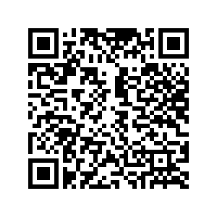
View Comparison Reports …
tinyurl.com/BAC042025
Notes:
https://mailmissouri.sharepoint.com/:b:/s/BudgetaryAffairsCommittee-Ogrp/EQR94VGR-RJKiPzG00UNTcMBhtVZ6dVYGHPsQW9TypuqvQ?e=cKcH3H

Slide 73
Updates and Plans
Update on T/TT New Hirings for Fall 25:
  19 active T/TT searches
  3 dept chairs
Ongoing BAC Action Plans
  Invite Deans to share their perspectives and action plans at a BAC meeting
  Invite key executive personnel to share perspectives at a BAC meeting
    Ms. Jill Warren, Chief of Staff, confirmed for May 7
  Action Feedback on the current issues and budgetary matters.
Many of these were successful, a few are still underway.

Slide 74
Feedback on Current Issues
Recurrent annual 10% strategic budget reallocation plan
Positions and salary trends between faculty and administrative personnel
Net Tuition Revenue
Distribution of Sponsored Research Indirect Recovery

Slide 75
Provide Feedback
https://tinyurl.com/SandTBudget

Slide 76
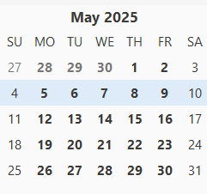
Information: Next Topic Request Due Date: 11:59 pm, 5-5-2025
All topics or questions submitted by May 5 will be reviewed at the May 7 BAC meeting, where the BAC will assess the following
  Urgencies and priorities of topics/questions
  data collection timeline
  Approach(es) to addressing each topic
  communication plans
Findings will then be communicated to the faculty during the June Faculty Senate meeting, another future meeting, or an appropriate communication channel.
Faculty Senates Meeting
Budgetary Affair Meeting
RP&A Meeting
DCC Meeting

Slide 77
VII. Committee Reports
B. Information Technology
D. Stutts

Slide 78
ITCC Meeting on March 18, 2025
Survey of IT performance report
  Thanks to collaborative work of Barry Robbinson, Aleksandr Chernatynskiy, Vadim Mochalin
  Summary of the report now (next slides)
  Full report will be published by May
  ITCC plans to repeat survey twice a year to track
  progress and update goals for IT/ITCC
…

Slide 79
IT Performance Survey Spring 2025 – Report
387 total responses:
  Staff: 244
  Faculty :130
  Other: 13
Some clear difference in perceiving IT between faculty and staff
  Staff views IT more favorably; faculty
Many “customer facing” IT personnel is viewed very positively

Slide 80
General View Of IT
Clear dichotomy between faculty and staff
  Differences in what resources and capabilities are needed

Slide 81
Top 3 Issues
Faculty members feel that IT does not provide adequate support for research and education, the two core missions of the university.
  Faculty members encounter numerous IT-related challenges, including
    slow service,
    complicated procedures,
    software installation delays, and
    restrictive policies (admin rights)
Staff reported issues on both technical aspects and service performance
  Outdated equipment, restricted access to applications, network connectivity problems
  Slow response times to repair tickets, convoluted processes, lack of communication and consistency in IT support.

Slide 82
Research and Teaching Questions
Q6. How strongly do you agree with statement: “IT policies greatly support my success in teaching and research.”
Naturally more related to faculty members (figures)
  Staff predominantly indicated ”balanced/neutral” response
For faculty, the overwhelming majority indicated negative opinion.
Q7. How do you rate the current balance between IT security needs versus research and education needs?

Slide 83
Top 3 Positives
Faculty most commonly indicate two “positives”
  that personnel is helpful and knowledgeable, especially at the library IT Helpdesk
    ”the people are not the problem, the system is”.
  A few positive mentions of “HPC research support”, “Classroom technology reliability”.
Staff appreciate
  the helpful and knowledgeable IT staff (again, IT Helpdesk),
  quick response times and how useful the Chat option is.

Slide 84
Top Issues to Address -> IT Actions
Faculty
  Need for a balance between security and research needs
Staff
  Improve conference rooms functionality
  Improve ticket resolution times
Common
  Affordability – reduce cost of computer purchases, issues with older PCs
  Improved service/tickets responsiveness; and improve communication
IT Actions
(already being implemented)
  Improved LAPS – https://laps.mst.edu
  New ticketing system – https://help.mst.edu/
  Near future – “SECURE PODS” phase 1
    more flexible network configuration
    4 buildings approved

Slide 85
VII. Committee Reports
C. Personnel
D. Westenberg

Slide 86
Personnel Committee
Dave Westenberg
Faculty/Staff Climate Survey
  Survey is open
  Encourage colleagues to complete
Ad hoc NTT committee on Policy III-13
Completed revisions of Teaching Improvement plans
  Discussion
  Next Steps

Slide 87
VIII. Unfinished Business
D. Westenberg

Slide 88
IX. New Business
D. Westenberg

Slide 89

Committee and Officer Elections
April 24, 2025

Slide 90

Faculty Senate Parliamentarian
The Parliamentarian makes recommendations to the President (or his/her/their delegate) on questions of parliamentary procedure for the Faculty Senate.
Have shifted this to a 3-year term that we re-approve each year.

Slide 91
Faculty Senate Parliamentarian
Electing 1 for the 4th year of a 3-year term
Mike Gosnell (CompSci)

Slide 92

Faculty Senate Secretary
The Secretary is responsible for all records, minutes, resolutions, and correspondence of the Faculty Senate. The Secretary supervises the publications of the agenda and the minutes of the meetings. The minutes shall be distributed by the Secretary of the Faculty Senate to all members of the General Faculty within ten (10) school days after the meeting.
Member of RP&A
Often becomes President-Elect

Slide 93
Faculty Senate Secretary
Electing 1 for a 1-year term
Frank (Daoru) Han (MAE)

Slide 94

Faculty Senate President-Elect
The President-Elect serves in the capacity of the President during the latter's absence, or upon the President's request. The President-Elect is also an assistant to the President.

Slide 95
Faculty Senate President-Elect
Electing 1 to a 1-year term
Joshua Schlegel (NERdS)

Slide 96
Faculty Senate President
The President presides at the meetings of the Faculty Senate. The President is the official spokesperson of the Faculty Senate and maintains open communications with the faculty, administration, staff, and students. The President is responsible for supervising all authority delegated by the Faculty Senate and for executing the decisions made by the Faculty Senate.

Slide 97
Faculty Senate President
Electing 1 to a 1-year term
Paul Runnion (Math/Stats)

Slide 98

Faculty Senate Past-President
Officer of Faculty Senate, serves on Intercampus Faculty Cabinet (IFC), chairs RP&A, maintains institutional knowledge, and organizes spring elections.
The only officer position that is NOT voted on.
Congratulations, David Westenberg!

Slide 99
Academic Freedom and Standards
This committee is concerned with the academic freedom of faculty and promoting academic excellence. It recommends and reviews policies concerning requirements for admission, graduation and academic standards.

Slide 100
Academic Freedom and Standards
Electing 3 to 2-year terms
Robin Verble (BIOSCI)
Bill Schonberg (CARE)
Paul Nam (Chem)
David Wang (BIT)
Tayfun Akyurek (NERdS)
Emilia Barbosa (ALP)
Lijun Jiang (ECE)
Kelly Tate (ETC)
Casey Canfield (EMSE)
Warner Meeks (MAE)

Slide 101
Budgetary Affairs
This committee makes recommendations to the Faculty Senate, the Chancellor and the Vice-Chancellor of Finance and Operations or the equivalent administrative office on matters concerning the long-range vision of the campus; plans to fulfill this vision; and budgetary matters as a consequence of the vision. These recommendations include, but are not limited to: all matters of a budgetary nature; and policies and priorities for strategic and tactical plans with goals of teamwork, fiscal transparency and shared governance. The committee studies the Campus budget, keeps informed of its preparation and status, and consults with and advises the Chancellor on all matters pertaining to budgetary affairs.

Slide 102
Budgetary Affairs (dept nominees)
Electing 2 to 2-year terms
Melanie Mormile (BIOSCI)
Michael Meagher (HPS)
Pericles Stavropoulos (Chem)
Ayodeji Alejo (NERdS)
Jagannathan Sarangapani (ECE)
Peggy Linder (EMSE)
Dave Bayless (MAE)

Slide 103
Budgetary Affairs (Faculty Senate nominee)
Electing 1 to a 2-year term
Kelly Homan (MAE)

Slide 104
Campus Curricula
This committee acts as an advisor and coordinator in regard to the disciplinary appropriateness and quality of curricular proposals, policies, and all course offerings. Proposals for curricula and course changes shall be submitted to the CCC via the Discipline-Specific Curricula Committee (DSCC) associated with the proposal. The DSCC recommendations shall be submitted with the proposal. Special Programs are not normally associated with a DSCC, and may submit proposals directly to the Campus Curricula Committee. Within 10 school days after receipt of the proposal, the CCC shall distribute copies to all departments via their DSCC representatives. Counter proposals submitted to the committee by the departmental representative of the concerned department should be considered when the original proposals are discussed. The recommendation of the committee shall be forwarded to the Faculty Senate for appropriate action.
The CCC will submit proposals for new graduate programs or any changes to existing graduate programs to the Graduate Faculty committee for approval prior to being considered by the Faculty Senate.

Slide 105
Campus Curricula
Electing 1 to a 2-year term (ONLY from Faculty Senate)
Michael Davis (Econ)

Slide 106
Facilities Planning Committee
This committee studies and makes recommendations to the Faculty Senate and the Chancellor concerning policies and priorities for physical facilities, including buildings, equipment, and land acquisition and use. The committee also makes recommendations to the Faculty Senate on policy pertaining to parking, security, traffic and matters affecting campus safety.

Slide 107
Facilities Planning Committee
4 elected total: 2 (2-year term) and 2 (1-year term)
Shelley Minteer (Chem)
Bil Gillis (CARE)
Rui Bo (ECE)
Monday Okoronkwo (ChBE)
Daoru (Frank) Han (MAE)
Carlos Castano (NERdS)

Slide 108
Facilities Planning Committee (Faculty Senate)
3 elected total: 2 (2-year term) and 1 (1-year term)
Steve Corns (EMSE)
Stuart Baur (CARE)
Maciej Zawodniok (ECE)

Slide 109
Honorary Degrees Committee
This committee meets at least annually, and reviews current and previous recommendations from the Campus for honorary degrees. The committee shall submit its recommendations first to the Faculty Senate and then to the Chancellor. After appropriate review by the Chancellor, recommendations are forwarded to the University of Missouri (UM) System Honors Committee. All names shall be held in strict confidence, with public announcements to be made only by the University of Missouri Board of Curators or the Chancellor.

Slide 110
Honorary Degrees Committee
Electing 4 for 1-year terms
Michael Meagher (HPS)
Steve Watkins (ECE)
Rui Bo (ECE)
John Myers (CARE)
Kelly Tate (ETC)
Hany Elazab (ChBE)
Jeff Winiarz (Chem)

Slide 111
Intellectual Property/Tech Transfer
This committee, in conjunction with Technology Transfer and Economic Development, is concerned with the formulation and implementation of policies and procedures related to intellectual property. It reviews and makes recommendations to the Faculty Senate, Chancellor and Provost on patent and copyright matters.

Slide 112
Intellectual Property/Tech Transfer (Faculty Senate)
Electing 3 for 2-year terms
Genda Chen (CARE)
Joseph Smith (Chem Eng)
Krishna Krishnamurthy (MAE)

Slide 113
Library and Learning Resources Committee
This committee makes recommendations to the Faculty Senate and appropriate administrative officials with respect to the administration of the Library and Learning Resources facilities and on rules governing use by students, faculty, and others. It shall consider all problems concerning the operation of the Library and its facilities.

Slide 114
Library and Learning Resources Committee
Electing 6 total: 4 (2-year term) and 2 (1-year term)
Gabriel Nicolosi (EMSE)
Yijia Gu (MSE)
Jeremy Maurer (ESE)
Michael Bruening (HPS)
Garry Grubbs (Chem)
Shradha Agarwal (NERdS)
Kathleen Sheppard (HPS)
Rui Bo (ECE)
Ed Malone (ETC)
Hossein Abedsoltan (ChBE)
Jianmin Wang (CARE)
Kris Bruckerhoff (BIT)

Slide 115
Personnel Committee
This committee recommends to the Faculty Senate general policies on the conditions of appointment, employment, compensation, and retirement of faculty and administrative officers. It also recommends reporting schemes and procedures regarding the annual salary and wage raise pool.

Slide 116
Personnel Committee
Electing 2 to 2-year terms
Pericles Stavropoulos (Chem)
Shoaib Usman (NERdS)
Steve Corns (EMSE)

Slide 117
Personnel Committee (Faculty Senate)
Electing 1 to a 2-year term
Dave Westenberg (BIOSCI)

Slide 118
Administrative Review
This committee sets policies and procedures for review of campus administrators ranking from Chancellor to Department Chair. The committee recommends the evaluation questionnaires and a plan/schedule for conducting reviews to the Faculty Senate. The committee conducts the reviews; oversees the sending of the evaluation forms to the evaluating persons; oversees the collection and collation of the resulting evaluations; and, along with the officers of the Faculty Senate, reviews and forwards the results of the evaluation to the Faculty Senate and the supervisors of the individual evaluated.

Slide 119
Administrative Review (Faculty Senate)
Electing 3 to 2-year term
Bih-Ru Lea (BIT)
Kelvin Erickson (ECE)
Kelly Liu (ESE)

Slide 120
Equity Resolution Hearing Pool
Per Chapter 600 of The Curators of the University of Missouri Collected Rules and Regulations, the Faculty Senate shall annually propose a list of twenty (20) faculty members to the Chancellor, from which ten (10) are selected by the Chancellor to serve in the panelist pool. The Chancellor also selects staff members to serve in the panelist pool. The University thereby creates and will annually train a pool of not less than ten (10) faculty and ten (10) administrators and/or staff to serve as hearing panel members in the Hearing Panel Resolution Process. Service in the panelist pool is a renewable one-year term.

Slide 121
Equity Resolution Hearing Pool
Need 20 nominees for the pool
Emilia Barbosa (ALP)
Greg Tschumpter (Chem)
Josh Schlegel (NERDS)
Amaury Lendasse (EMSE)
Grace Yan (CARE)

Slide 122
Parking, Security, and Traffic (Judicial)
The committee oversees application of rules and regulations concerning parking and traffic. It functions according to the principles stated in The Curators of the University of Missouri Collected Rules and Regulations.

Slide 123
Parking, Security, and Traffic (Judicial)
Electing 6 total: 3 (2-year term) and 3 (1-year term)
Michael Meagher (HPS)
Risheng Wang (Chem)
Robert Paige (Math)
Parveen Bazard (ChBE)
Steve Corns (EMSE)
Kris Bruckerhoff (BIT)

Slide 124
Student Scholastic Appeals (Judicial Committee)
This committee establishes procedures for individual student scholastic appeals. The committee shall consider and rule on all individual cases of appeal relating to student scholastic performance, including but not limited to: graduation with honors, probation and dropping from school, readmission after being dropped for scholastic reasons, scholastic deficiencies and evaluation of credit and transfer of credits, grades and honor points from other campuses to Missouri S&T. It serves as an appeal board for cases of students on scholastic probation who are involved in the activities of organizations.

Slide 125
Student Scholastic Appeals (Judicial Committee)
Electing 3 total: 2 (2-year term) and 1 (1-year term)
Jeffery Winiarz (Chem)
Joan Schuman (EMSE)
Greg Tschumper (Chem)

Slide 126
Conflict of Interest (Special Committee)
Chair-senior level administrator-appointed by Chancellor or designee (Chair will also serve as the Missouri S&T COI Officer) – (3-year term) 3 Tenured Faculty Members appointed by Faculty Senate – (3-year) term (two appointments initially will be for a (2-year) term to stagger new appointments) 1 Division of Administrative Services Representative - appointed by Chancellor or designee – (3-year) term

Slide 127
Conflict of Interest (Faculty Senate)
Electing 2 to 3-year terms
Amitava Choudhury (Chem)
Jianmin Wang (CARE)

Slide 128
Grievance Oversight (Judicial Committee)
(1) A member of the OC will be appointed to each grievance case following receipt of a Grievance Filing Form by the GRP. The OC representatives are observers of the confidential grievance processes: The OC representative may not participate in the deliberations or rendering of findings and recommendations by the GRP but provides a summative, evaluative report of each grievance process without conveying substantive information. The representatives also monitor the implementation of remedies that result from a grievance process.

Slide 129
Grievance Oversight (Faculty Senate)
Electing 1 to 3-year terms
Grace Yan (CARE)
Kris Bruckerhoff (BIT)

Slide 130
No more!!
Thank you for your service!

Slide 131
X. Announcements
D. Westenberg

Slide 132
XI. Adjourn

Slide 133
Thank You
D. Westenberg
President, Faculty Senate
djwesten@mst.edu
facultysenate.mst.edu

